Slide 1
PERINEUM
BY: M. G. HAMMAD

Slide 2
FEMALE UROGENITAL TRIANGLE

Slide 3
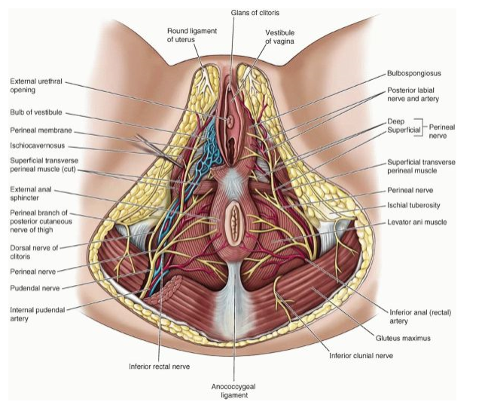
Female Urogenital Triangle
The female urogenital triangle includes:
Female external genitalia.
Perineal muscles.

Slide 4
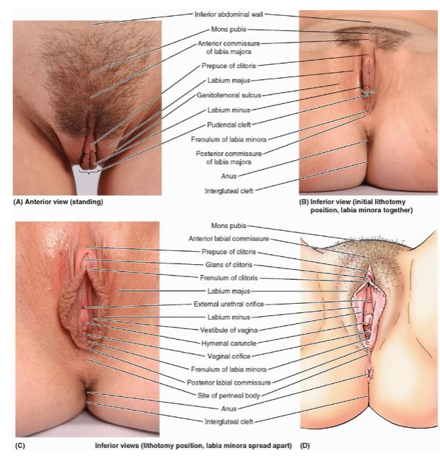
FEMALE EXTERNAL GENITALIA
Female external genitalia include:
Mons pubis.
Labia majora (enclosing the pudendal cleft).
Labia minora (enclosing the vestibule of vagina).
Clitoris.
Bulbs of vestibule.
Greater and lesser vestibular glands.
The terms vulva and pudendum include all these parts.
The term pudendum is commonly used clinically.

Slide 5
FEMALE EXTERNAL GENITALIA
VULVA:
Function:
Sensory and erectile tissue for sexual arousal and intercourse.
Directs the flow of urine.
Prevents entry of foreign material into the urogenital tract.

Slide 6
FEMALE EXTERNAL GENITALIA
MONS PUBIS:
Rounded, fatty eminence anterior to:
Pubic symphysis.
Pubic tubercles.
Superior pubic rami.
It formed by a mass of fatty subcutaneous tissue.
The amount of fat increases at puberty and decreases after menopause.
The surface of the mons is continuous with the anterior abdominal wall.
After puberty, the mons pubis is covered with coarse pubic hairs.

Slide 7
FEMALE EXTERNAL GENITALIA
LABIA MAJORA:
Are prominent folds of skin.
Indirectly protect:
Clitoris.
Urethral orifice.
Vaginal orifice.
Labia majora features:
Filled with loose subcutaneous tissue.
Containing smooth muscle and the termination of round ligament of the uterus.

Slide 8
FEMALE EXTERNAL GENITALIA
LABIA MAJORA:
Labia majora features:
Passes inferior- posteriorly from the mons pubis toward the anus.
Lie on the sides of a central depression {pudendal cleft}.
In adult: covered with pigmented skin containing sebaceous glands and are covered with crisp pubic hair.
The internal aspects are smooth, pink, and hairless.
Are thicker anteriorly where they join to form {anterior commissure}.
Posteriorly: in nulliparous women they form {posterior commissure}.
PC overlies perineal body.
It is the posterior limit of the vulva.
It usually disappears after the first vaginal birth.

Slide 9
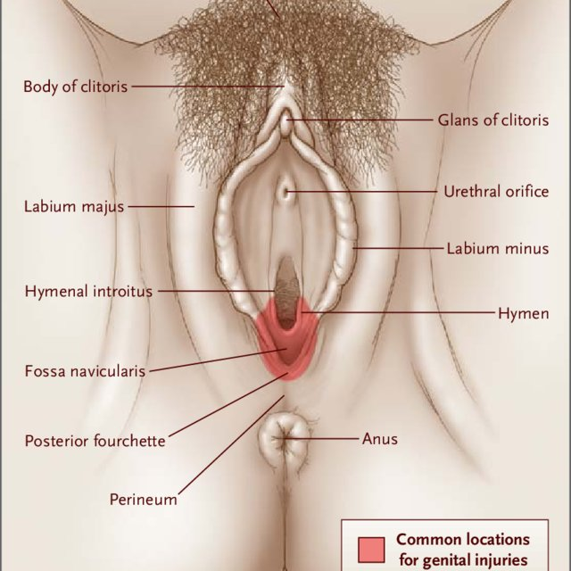
FEMALE EXTERNAL GENITALIA
LABIA MINORA:
Are rounded folds of fat-free, hairless skin.
They are enclosed in the pudendal cleft.
They surround external urethral and the vaginal orifices.
They have:
Core of spongy connective tissue containing erectile tissue at their base.
Many small blood vessels.

Slide 10
FEMALE EXTERNAL GENITALIA
LABIA MINORA:
Anteriorly: labia minora form two laminae:
Medial laminae:
Of both side unite as the {frenulum of the clitoris}.
Lateral laminae:
Unite anterior to glans of the clitoris, forming prepuce (foreskin) of the clitoris.
Posteriorly: In young virgin women:
Labia minora are connected by a small transverse fold {frenulum of the labia minora (fourchette)}.
Internal surface of each labium minus consists of thin moist skin.
It has the pink color typical of mucous membrane.
Contains many sebaceous glands and sensory nerve endings.

Slide 11
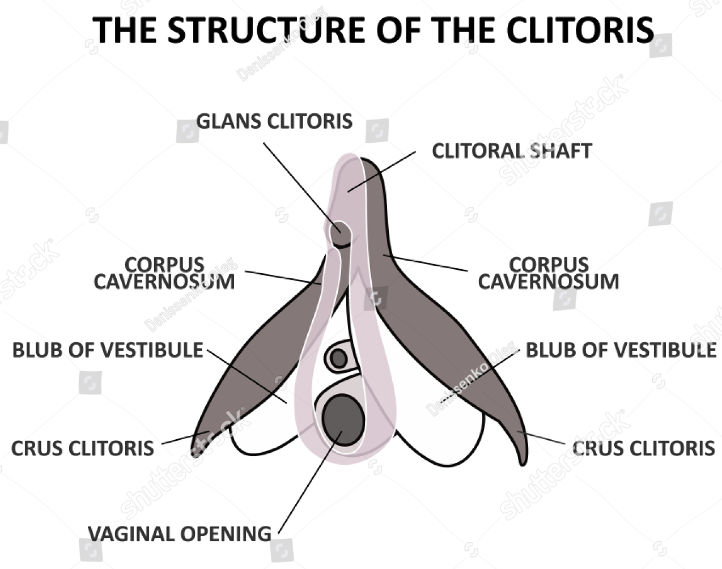
FEMALE EXTERNAL GENITALIA
CLITORIS:
An erectile organ located where the labia minora meet anteriorly.
It has 2 parts:
Root.
Small, cylindrical Body.
Its structures include:
Two crura.
Two corpora cavernosa.
Glans of the clitoris.

Slide 12
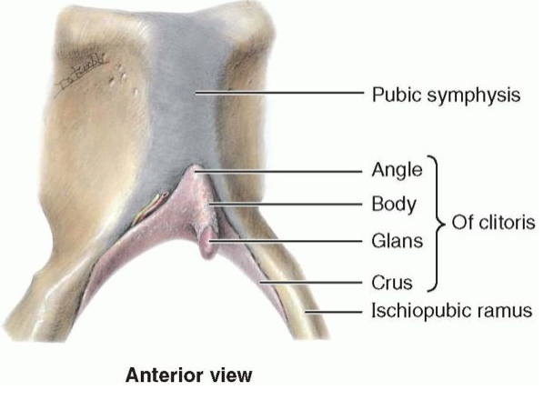
FEMALE EXTERNAL GENITALIA
CLITORIS:
Crura attach to inferior pubic rami and perineal membrane, deep to the labia.
Body of the clitoris is covered by the prepuce.
Body and glans of the clitoris are approximately 2 cm in length and <1 cm in diameter.
Clitoris is not functionally related to the urethra or to urination.
It functions as an organ of sexual arousal.
The clitoris is highly sensitive and enlarges on tactile stimulation.
The glans of the clitoris is the most highly innervated part of the clitoris.
It is densely supplied with sensory endings.

Slide 13
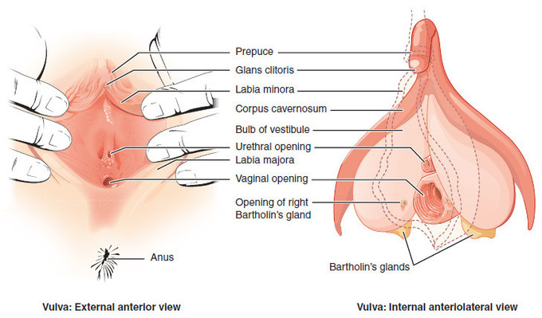
FEMALE EXTERNAL GENITALIA
VESTIBULE OF VAGINA:
Space surrounded by the labia minora.
Receives orifices of:
Urethra.
Vagina.
Ducts of greater and lesser vestibular glands.
External urethral orifice located 2-3 cm posteroinferior to glans of clitoris and anterior to vaginal orifice.
On each side of external urethral orifice are openings of paraurethral glands.
Openings of greater vestibular glands are located on the upper, medial aspects of labia minora.

Slide 14
FEMALE EXTERNAL GENITALIA
VESTIBULE OF VAGINA:
Vaginal Orifice:
Vary in size and appearance.
This variation depends on condition of hymen.
Hymen:
A thin annular fold of mucus membrane.
It partially or wholly occludes the vaginal orifice.
After its rupture, only remnants of the hymen {hymenal caruncles (tags)} are visible.
These remnants demarcate the vagina from the vestibule.

Slide 15
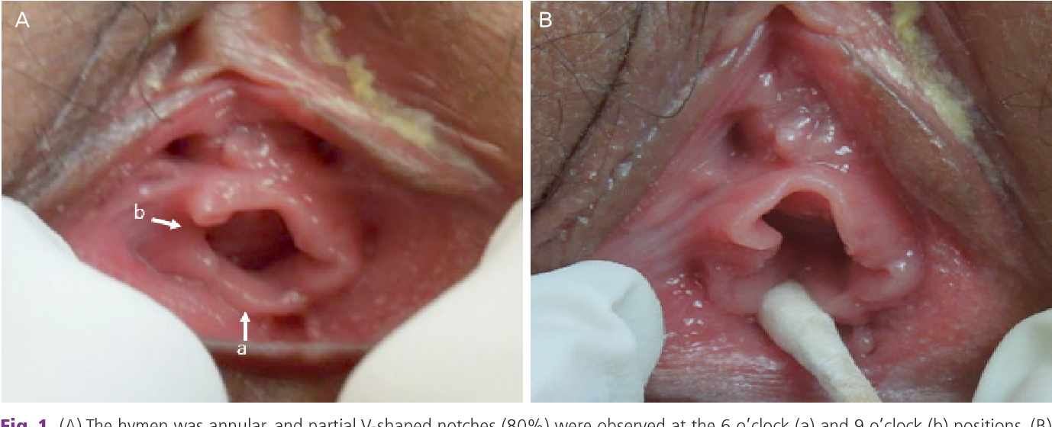
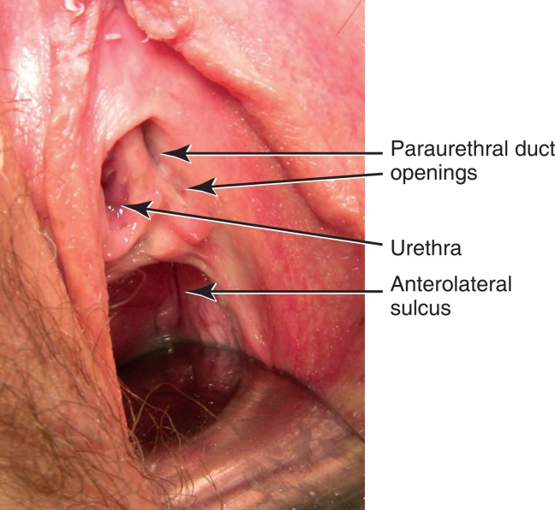
FEMALE EXTERNAL GENITALIA

Slide 16
FEMALE EXTERNAL GENITALIA
BULBS OF VESTIBULE:
Are paired masses of elongated erectile tissue.
Approximately 3 cm in length.
They lie:
Along the sides of the vaginal orifice.
Superior or deep to labia minora.
Immediately inferior perineal membrane.
They are covered inferiorly and laterally by bulbospongiosus muscles.
They are homologous with the bulb of the penis.

Slide 17
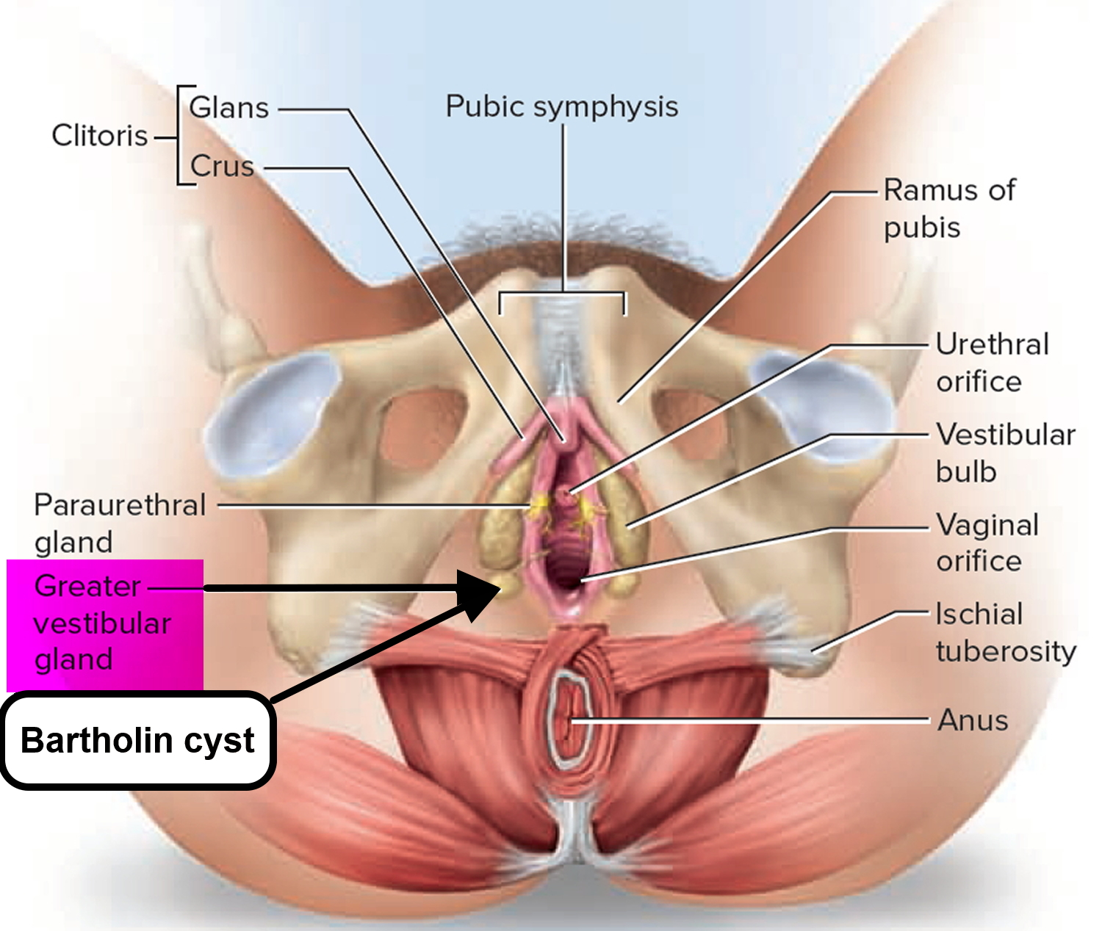
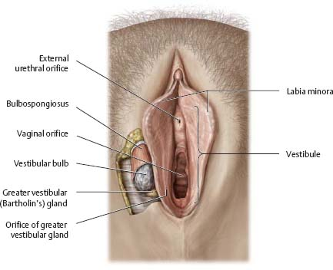
FEMALE EXTERNAL GENITALIA
VESTIBULAR GLANDS:
Are 2 groups:
Greater vestibular glands (Bartholin glands):
Approximately 0.5 cm in diameter.
Location:
In the superficial perineal pouch.
On each side of the vestibule.
Posterolateral to the vaginal orifice.
Inferior to the perineal membrane.
Greater vestibular glands are round or oval and are partly overlapped posteriorly by the bulbs of the vestibule.
They are partially surrounded by the bulbospongiosus muscles.

Slide 18
FEMALE EXTERNAL GENITALIA
VESTIBULAR GLANDS:
Greater vestibular glands (Bartholin glands):
Their ducts pass deep to the bulbs of the vestibule.
Open into the vestibule on each side of the vaginal orifice.
They secrete mucus into the vestibule during sexual arousal.

Slide 19
FEMALE EXTERNAL GENITALIA
VESTIBULAR GLANDS:
Lesser vestibular glands:
Small glands on each side of the vestibule of vagina.
Open into vestibule between the urethral and the vaginal orifices.
These glands secrete mucus into the vestibule, which moistens the labia and vestibule.

Slide 20
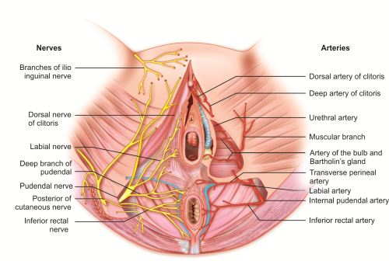
FEMALE EXTERNAL GENITALIA
BLOOD SUPPLY OF VULVA:
Arterial Supply:
From external and internal pudendal arteries.
Internal pudendal artery: supplies:
Most of the skin.
External genitalia.
Perineal muscles.
It gives:
Labial branch.
Clitoral branches.
Urethral branch.
Muscular branches.
Bulbar & glandular branches.

Slide 21
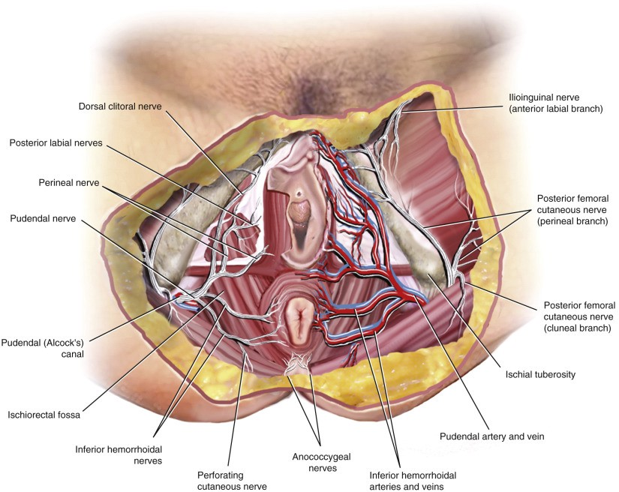
FEMALE EXTERNAL GENITALIA
BLOOD SUPPLY OF VULVA:
Venous Return:
Corresponding to arteries.
Drain to INTERNAL PUDENDAL vein.

Slide 22
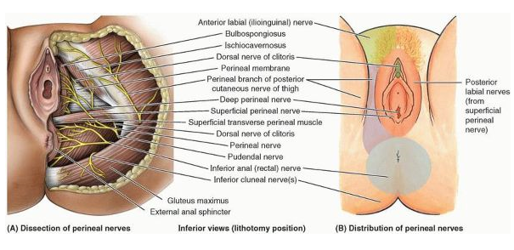
FEMALE EXTERNAL GENITALIA
NERVE SUPPLY OF VULVA:
Anterior aspect vulva(mons pubis, anterior labia):
Supplied by derivatives of the lumbar plexus:
Anterior labial nerve {ilioinguinal nerve}.
Genital nerve {genitofemoral nerve}.
Posterior aspect of vulva:
Supplied by derivatives of the sacral plexus:
Perineal branch of the posterior cutaneous nerve of thigh {laterally}.
Pudendal nerve {centrally}.
Pudendal N: supplies superficial perineal muscles.
Dorsal N of clitoris: supplies: deep perineal muscles and sensation to clitoris.
Bulb of vestibule and erectile bodies of clitoris: receive parasympathetic fibers via cavernous nerves from the uterovaginal nerve plexus.

Slide 23
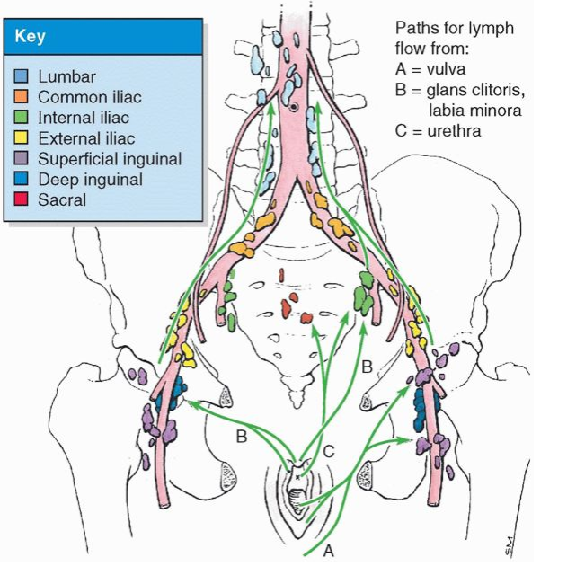
FEMALE EXTERNAL GENITALIA
Lymphatic Drainage Of The Female Perineum:
Vulva contains a rich network of lymphatic vessels.
It drains its lymph to:
Superficial inguinal lymph nodes
Deep inguinal lymph nodes

Slide 24
THANKS

